Slide 1

Building Intelligent Cross Platform Mobile Applications using Xamarin & Azure Search
Liam Cavanagh
Principal Program Manager – Azure Search
@liamca

Slide 2

Topics
Goal:
Learn how to extend Xamarin mobile applications to build intelligent search experiences
What you will learn:
What is a search enabled application and how can it enhance your mobile application
How to add intelligence to your mobile application using Machine Learning & Azure Search

Slide 3
Topics
Assumptions
General understanding of the Xamarin platform
What we will not cover
“Getting Started with Xamarin” – Highly recommend you review these videos first: https://developer.xamarin.com/guides/cross-platform/getting_started/

Slide 4
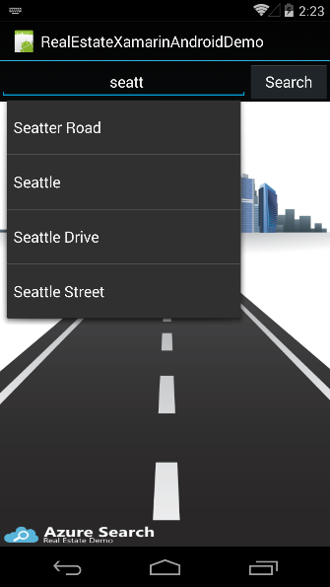
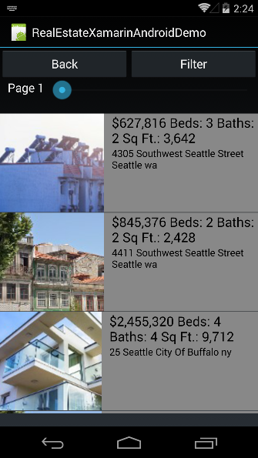
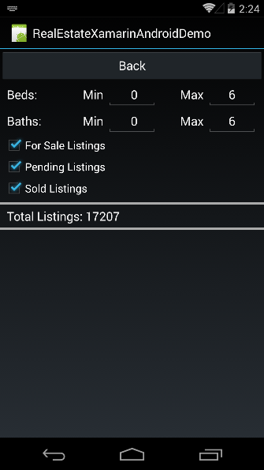
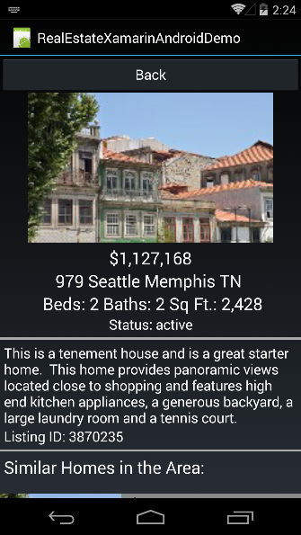
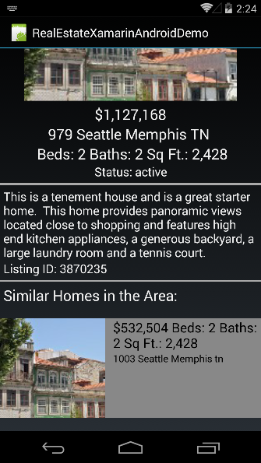
What we will build
Real Estate application that targets Android
Enable features such as:
Full text search of listings & type-ahead search
Tuning search results
Search result filtering & faceting
Geo-spatial search
Synonyms and spelling mistakes support
Analytics to enhance the user experience

Slide 5
Tutorial Resources
All source and lab resources can be found on GitHub:
https://aka.ms/azsearchxamarin
Azure Search Documentation
https://azure.microsoft.com/en-us/documentation/services/search/

Slide 6
What you will need
Visual Studio 2015 with Xamarin and Android emulator
Optional
Azure Search service: https://azure.microsoft.com/free
Chrome Postman for REST API calls https://chrome.google.com/webstore/detail/postman/fhbjgbiflinjbdggehcddcbncdddomop?hl=en

Slide 7

Lesson 1 Topics
What is Azure Search and what is a search enabled mobile application
Examples where search enabled applications are used
How to create, manage and use an Azure Search service

Slide 8

What is Azure Search?
A search-as-a-service solution allowing developers to incorporate great search experiences into applications without managing infrastructure or needing to become search experts.
“Simplify the Search Experience”

Slide 9

Why?
Developers look for PaaS services to
achieve better results faster in their apps
Search is key to many categories of applications
Web search engines have set the bar high for search
Instant results, auto-complete, hit highlighting, great ranking, linguistics
Search is hard and rarely a core expertise area
Infrastructure standpoint: availability, durability, scale, operations
Functionality standpoint: ranking, language support, geo-spatial

Slide 10
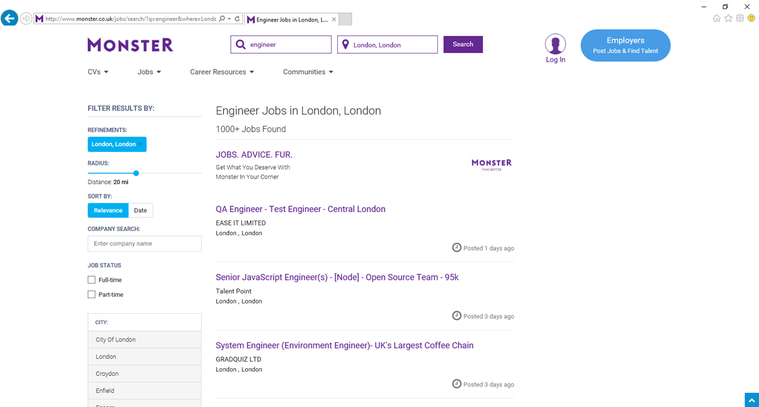
Sorting
Ranking
Facets

Slide 11
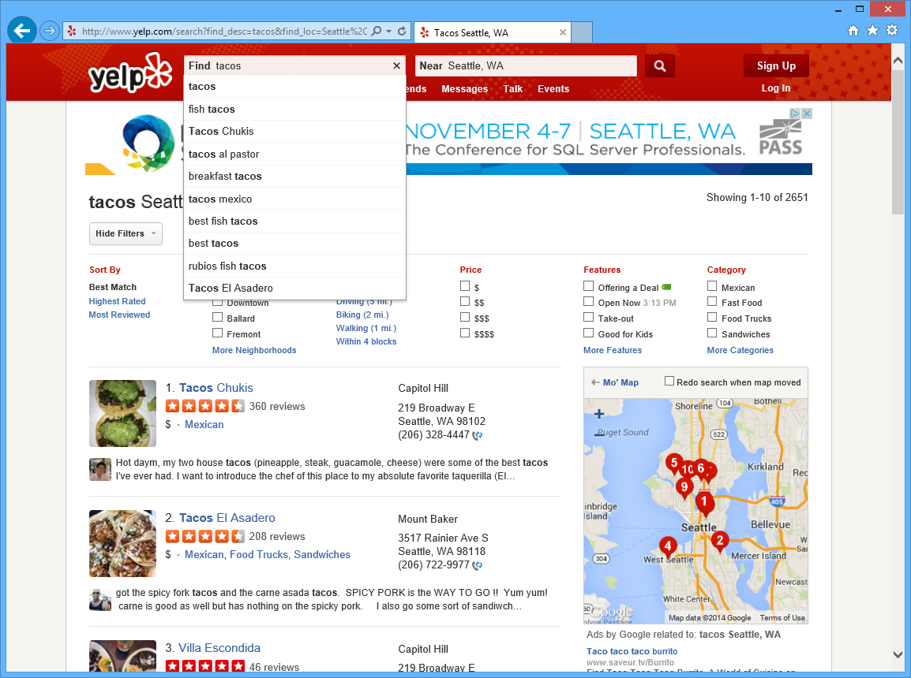
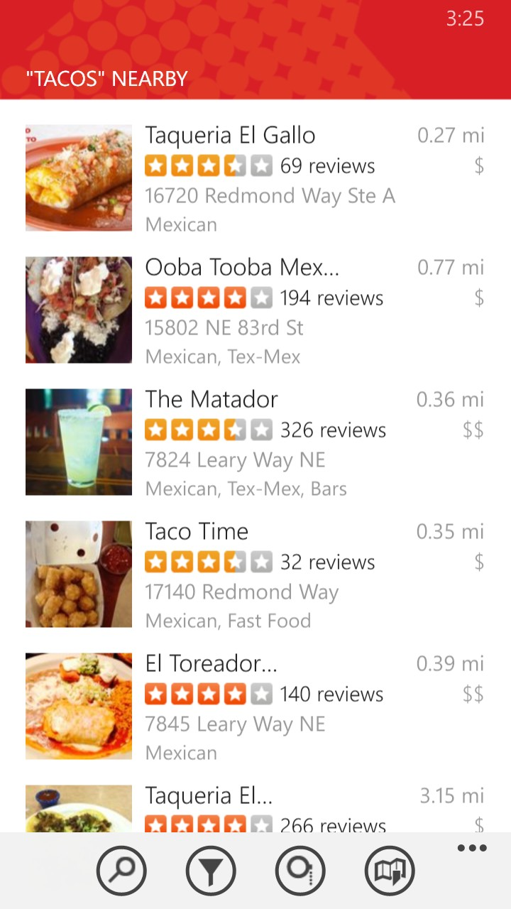
Location
Suggestions
Filters
Scoring
Geospatial
Filters

Slide 12
Typical Workflow
Provision service
Create index
Index data
Search

Slide 13
“Search service”
Scope for capacity
Bound to a region
Has keys, indexes, indexers, data sources
Provisioning
Azure Portal
Azure resource management API
Elastic scale
Capacity can be changed dynamically
Replicas ~ more QPS, HA
Partitions ~ more documents, write throughput
Provision service
Create index
Index data
Search

Slide 14

Demo

Slide 15
“Index”
Container for data, think “table”
Has schema, CORS options, search options
Create in portal or during app initialization
Typical schema
Fields definition: name, type, key
Search specifics
Field attributes – searchable, facetable, etc.
Linguistics and analysis
Suggesters for auto-complete
Scoring profiles for ranking tuning
Provision service
Create index
Index data
Search

Slide 16
Linguistics
Linguistics are key in search
Support for 56 languages
Word breaking, stop words, inflections
Lucene analyzers
Well-known analyzer stack
Stemming
Microsoft analyzers
Same NLP stack used by parts of Office, Bing
Deep understanding of languages
Lemmatization in many languages

Slide 17
Push - using indexing API
POST to /indexes/<name>/docs/index
Up to 1000 actions per batch
Actions can be upload, merge, delete, etc.
Pull - using indexers
Azure SQL DB, DocumentDB Tables and Blob
Change detection, deletion markers
Point it at the data source, define policy, done
Provision service
Create index
Index data
Search

Slide 18
Demo

Slide 19
Search + typical data operations
Simple search options, + - * () “”
Filter, sort, project, page over results
Spelling mistakes, phonetic and RegEx
Options work with search and suggest
Search from client or server
Use query keys when searching from clients
CORS allows direct calls from browsers
Render from search results
Include necessary non-searchable data
E.g. URLs for pictures, keys to main content
Provision service
Create index
Index data
Search

Slide 20
Custom relevance
Scoring profiles
Field weights
Scoring functions
magnitude, freshness, distance, tags
3 main patterns
Known data directly available in the index
Personalization using tag boosting
Analytics, compute externally and push to the index

Slide 21
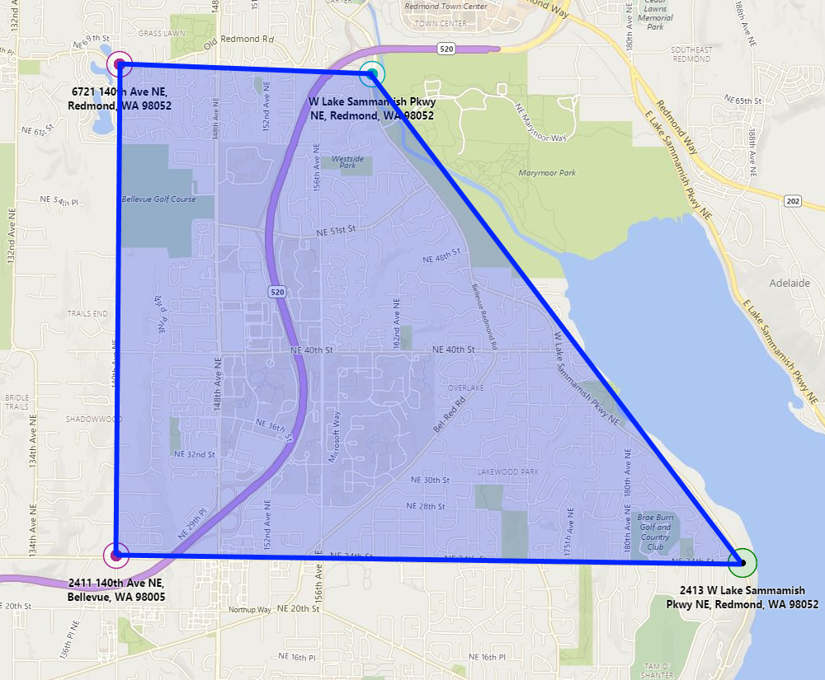
Geospatial
Full geospatial support built-in
Store
Geography point instances as GeoJSON
Query
Filter by distance and
bounding box
Sort by distance
Ranking
Boost items based on
distance

Slide 22
Demo
SQL Database Server: yczff1wo7l.database.windows.net
Database: realestate
Read Only User: reader
Password: EdrERBt3j6mZDP

Slide 23
Lesson 2 –Type Ahead
Example Type Ahead Query:
https://realestate.search.windows.net/indexes/listings/docs/suggest?api-version=2015-02-28&suggesterName=sg&search=seat
All source and lab resources can be found on GitHub:
https://aka.ms/azsearchxamarin

Slide 24
Demo

Slide 25
Lesson 3 – Search & Paging
Example Search Query:
https://realestate.search.windows.net//indexes/listings/docs?api-version=2015-02-28-Preview&search=seattle
Get Page 3 with 10 Listings / Page:
https://realestate.search.windows.net//indexes/listings/docs?api-version=2015-02-28-Preview&search=seattle&$top=10&$skip=20
All source and lab resources can be found on GitHub:
https://aka.ms/azsearchxamarin

Slide 26
Demo

Slide 27
Lesson 4 – Filtering Search Results
Example Facet Search Query:
/indexes/listings-full/docs?api-version=2015-02-28&search=seattle&facet=beds
Example Filter Search Query:
/indexes/listings-full/docs?api-version=2015-02-28&search=seattle&$select=address,area&$filter=beds gt 2
All source and lab resources can be found on GitHub:
https://aka.ms/azsearchxamarin

Slide 28
Demo

Slide 29
Lesson 5 – Lookup
Example Document Lookup Search Query:
/indexes/listings-full/docs/1174787?api-version=2015-02-28
All source and lab resources can be found on GitHub:
https://aka.ms/azsearchxamarin

Slide 30
Demo

Slide 31
Lesson 6 – More Like This
Example Document Lookup Search Query:
/indexes/listings/docs?api-version=2015-02-28-Preview&morelikethis=1174787
All source and lab resources can be found on GitHub:
https://aka.ms/azsearchxamarin
Recommendations Example:
github.com/liamca/azure-search-recommendations

Slide 32
Demo

Slide 33

Lesson 7 – Scoring and Tuning
Scoring profiles
Field weights
Scoring functions
magnitude, freshness, distance, tags
3 main patterns
Known data directly available in the index
Personalization using tag boosting
Analytics, compute externally and push to the index

Slide 34

Tuning Results based on Users Geo-Location
Nuget Package Used (GeoLocator)
https://www.nuget.org/packages/Xam.Plugin.Geolocator
Example Azure Search Request
&scoringProfile=geoScoring&scoringParameter=currentLocation:-122.130,47.641
More Info:
https://blog.xamarin.com/geolocation-for-ios-android-and-windows-made-easy/
https://msdn.microsoft.com/en-us/library/dn798928.aspx
All source and lab resources can be found on GitHub:
https://aka.ms/azsearchxamarin

Slide 35
Demo

Slide 36
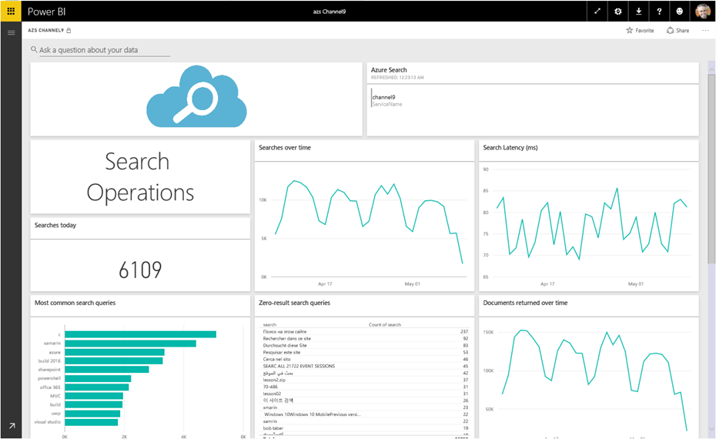
Lesson 8 – Catering to the Long Tail
“70% of searches are unexpected”¹

Slide 37
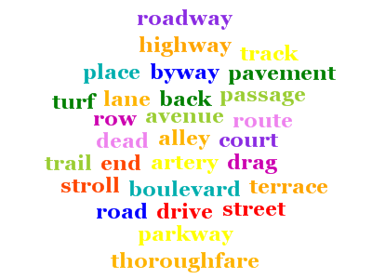
Synonyms (Preview)
Associate equivalent terms that implicitly expand the scope of a query, without user having to actually provide terms. For example:
"dog" can be associated with “canine” & “puppy”
Synonyms are currently in preview, exclusive to the Service REST API (api-version=2015-20-28-preview)
Word mappings is defined in a “synonym map” and is linked to one or more Index fields using synonymMaps in the field definition
Synonyms can be updated as needed
Ties in well with Search Traffic Analytics (Searches with 0 Results)

